Slide 1
Web Service Recommendation
汇报人：杨扬
导师：张明卫

Slide 2
01
QOS recommendation
目录
02
Others
CONTENTS
03
Reference

Slide 3
PART
TWO
QOS

Slide 4
QOS recommendation
Mashup and Service
mashup
service
service
service

Slide 5
QOS recommendation
QOS（Quality of Service）
service1
service2
service3
相同功能，不同性能

Slide 6
QOS recommendation
Matrix Factorization
collaborative filtering
 | Service1 | Service2 | Service3 | …… | Servicen
User1 | 1 | 0.5 | 0.7
User2
…… |  |  |  |  | 1
Usern |  | 1.5 |  | 3

Slide 7
PART
THREE
Others

Slide 8
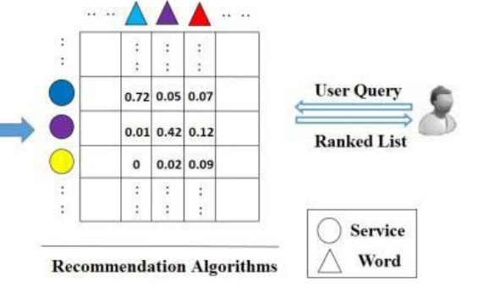
Reconstructed Profile From Mashup Descriptions(18)
大体流程

Slide 9
Reconstructed Profile From Mashup Descriptions(18)
基本概念
service1
descriptions
mashup
descriptions
service2
descriptions

Slide 10
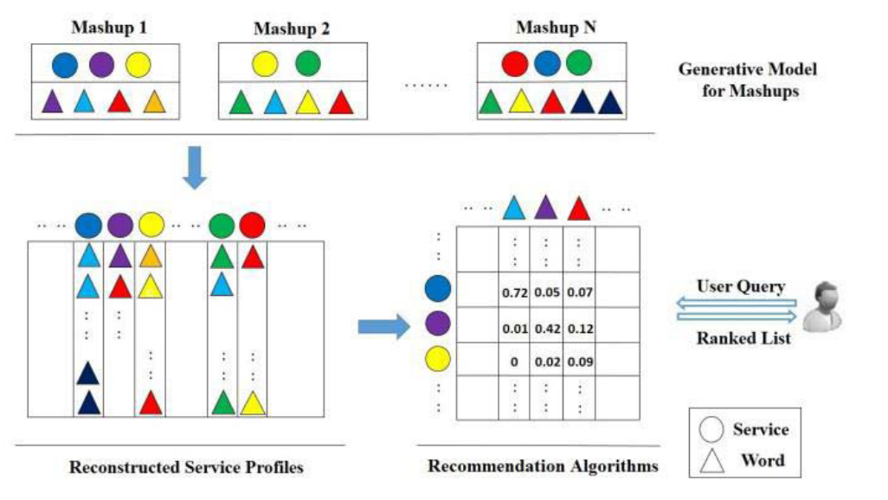
Reconstructed Profile From Mashup Descriptions(18)
大体流程

Slide 11

Reconstructed Profile From Mashup Descriptions(18)
Ranking
words
service

Slide 12

A Deep Learning Framework for Recommendations of Long-Tail Web Services（20）
长尾效应（Long-Tail）
长尾效应的根本就是强调“个性化”，“客户力量”和“小利润大市场”，也就是要赚很少的钱，但是要赚很多人的钱。要将市场细分到很细很小的时候，然后就会发现这些细小市场的累计会带来明显的长尾的效应。将所有的非流行的市场，累加起来就会形成一个巨大的市场，甚至比主流市场还要巨大。

Slide 13
A Deep Learning Framework for Recommendations of Long-Tail Web Services（20）
数据特点
learn the patterns of developers’ preference instead of modeling individual services
历史使用数据严重稀疏
服务描述信息质量差
SDAE(stacked denoising autoencoders)进行特征提取

Slide 14
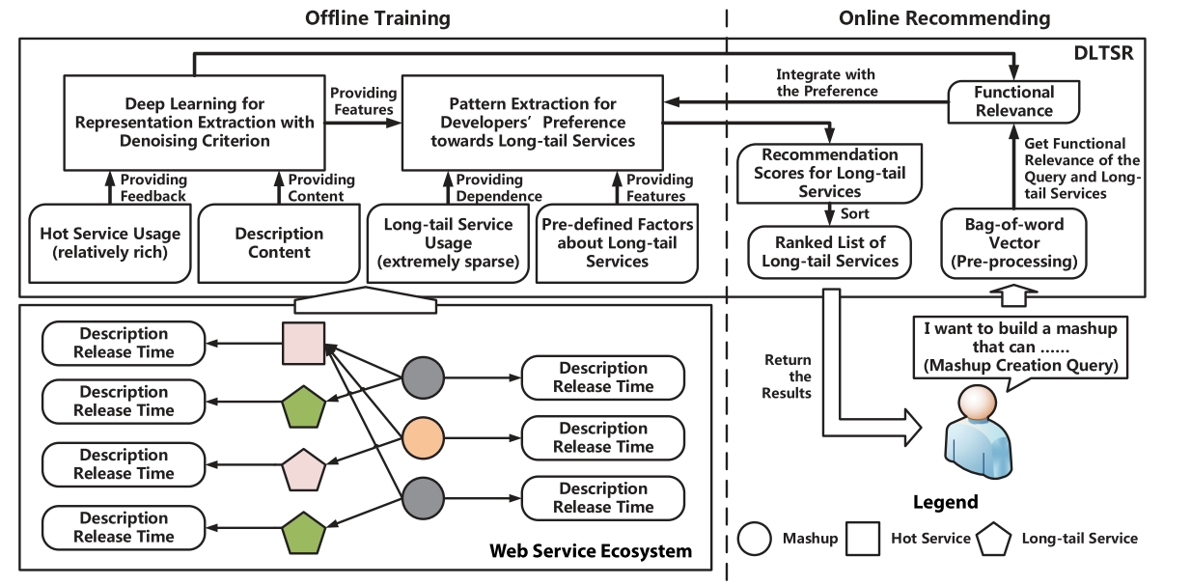
A Deep Learning Framework for Recommendations of Long-Tail Web Services（20）
DLTSR
Deep learning for Long- Tail web Service Recommendations

Slide 15

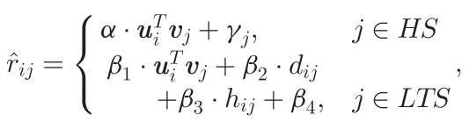
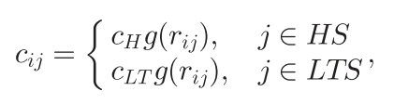

A Deep Learning Framework for Recommendations of Long-Tail Web Services（20）
Rating

Slide 16
A Deep Learning Framework for Recommendations of Long-Tail Web Services（20）
Dataset_api.xml
programmableWeb
<RECORD>
<name>#blue</name>
<description>
#blue is a service that stores text messages in a conversational style. with this api, client apps can, on behalf of users, do almost anything that can be done through the #blue website. this includes reading and sending messages, creating and updating contacts, and marking messages as favorites. the service is only available to o2 subscribers in the uk at this time. the api uses restful calls and responses are formatted in json.
</description>
<primary_category>messaging</primary_category>
<secondary_categories>england</secondary_categories>
<date>tuesday, april 19, 2011 - 11:38</date>
<identification>#bluetuesday, april 19, 2011 - 11:38</identification>
</RECORD>

Slide 17
A Deep Learning Framework for Recommendations of Long-Tail Web Services（20）
Dataset_mashup.xml
<RECORD>
<name>#beermap - the top 2,500 beers on twitter</name>
<description>
to discover the most popular beer in over 15000 cities across the us, canada, the uk, and ireland, peekanalytics mapped the consumer followers of over 2500 beer and microbrewery twitter accounts.
</description>
<tags>analytics , beer , humor</tags>
<apis>google maps , twitter , peekyou social analytics</apis>
<date>thursday, september 19, 2013 - 01:57</date>
<identification>#beermap - the top 2,500 beers on twitterthursday, september 19, 2013 - 01:57</identification>
</RECORD>

Slide 18
PART
FOUR
参考文献

Slide 19
References
[1] Zhu R , Niu D , Li Z . Robust web service recommendation via quantile matrix factorization[C]// IEEE INFOCOM 2017 - IEEE Conference on Computer Communications. IEEE, 2017.
[2] Zhong Y , Fan Y , Tan W , et al. Web Service Recommendation With Reconstructed Profile From Mashup Descriptions[J]. IEEE Transactions on Automation ence & Engineering.
[3] Bai B , Fan Y , Tan W , et al. DLTSR: A Deep Learning Framework for Recommendation of Long-tail Web Services[J]. IEEE Transactions on Services Computing.

Slide 20
THANKS

